Slide 1
FPGA PONG
CECS 361 Spring 2022
Abhishek & Anand Jasti

Slide 2
INTRODUCTION
PONG GAME USING FPGA BOARD WITH VGA DISPLAY
PONG GAME DISPLAYED AT 800X600 RESOLUTION AT 75Hz
DONE BY USING A BASIC CLOCK DIVIDER
AND BY USING A VERTICAL AND HORIZONTAL SYNC GENERATOR
GAME IS CONTROLLED BY THE TWO RIGHTMOST AND TWO LEFTMOST SWITCHES
USING DEBOUNCE FUNCTION TO PREVENT UNINTENTIONAL MISINPUTS

Slide 3
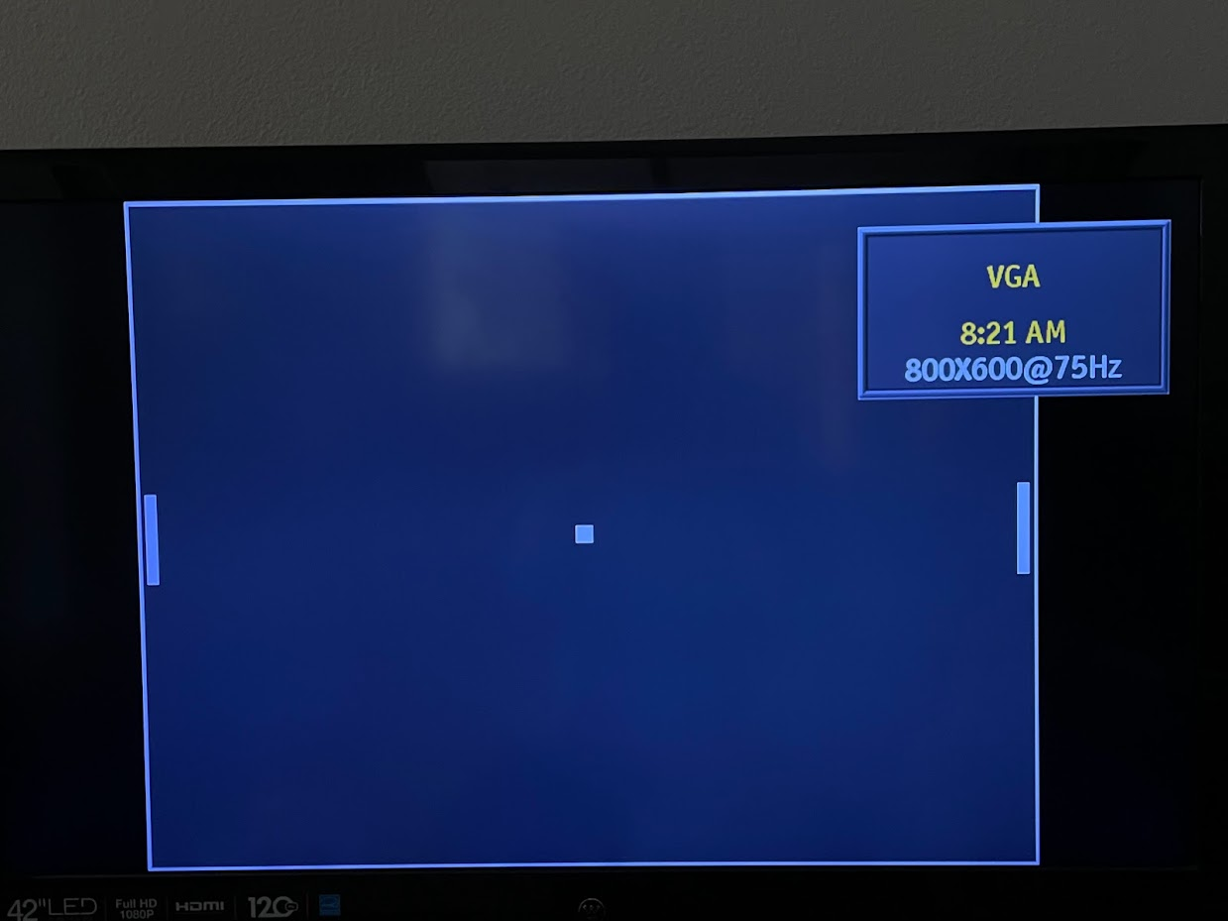
GAME
2D SPORTS GAME SIMULATING TABLE TENNIS
PLAYER 1 CONTROLS AN IN-GAME PADDLE WITH THE RIGHTMOST TWO SWITCHES
PLAYER 2 CONTROLS AN IN-GAME PADDLE WITH THE LEFTMOST TWO SWITCHES
GOAL IS FOR EACH PLAYER TO REACH 3 POINTS
POINTS ARE EARNED WHEN ONE PLAYER FAILS TO RETURN THE BALL TO THE OTHER PLAYER

Slide 4
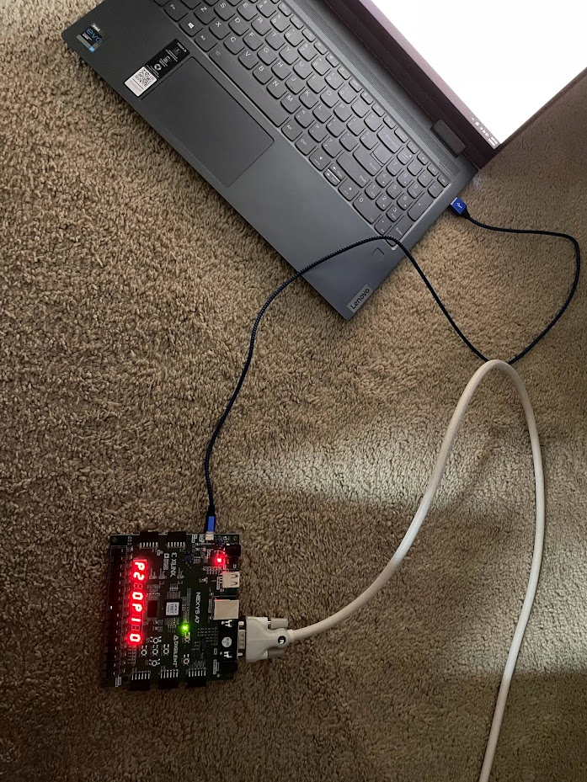
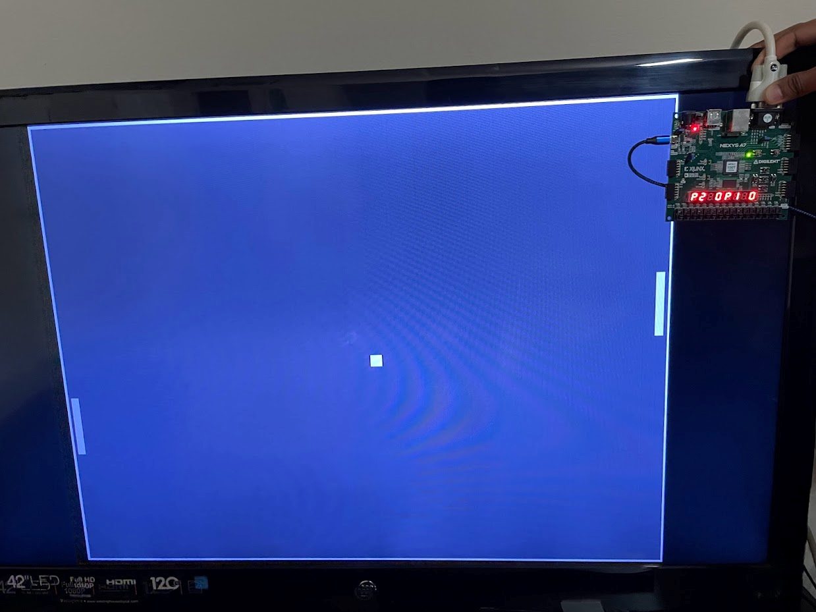
RUNTIME
Game controlled by onboard switches.
Score increments upon making the other player miss.(couldn’t implement)
Ball always spawn in the middle at reset.
Ball randomizes direction after players start the game.

Slide 5
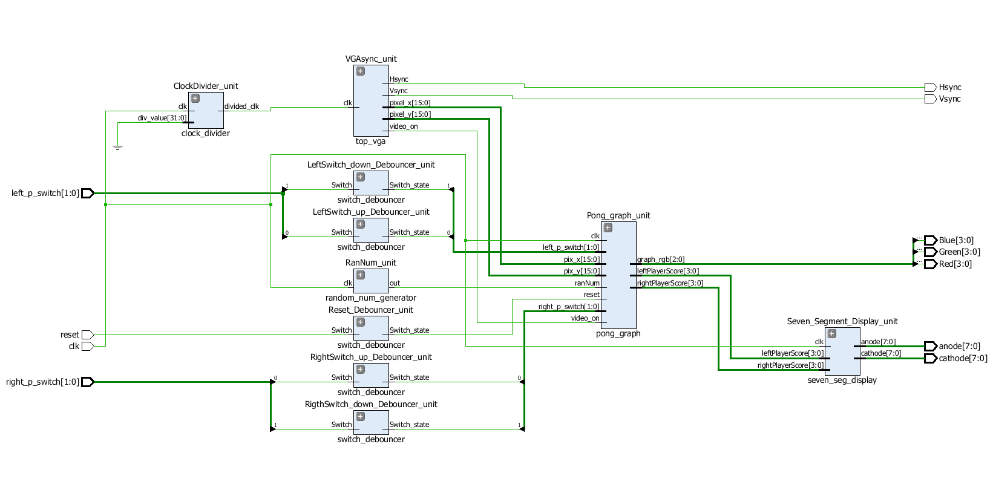
DESIGN DIAGRAM

Slide 6
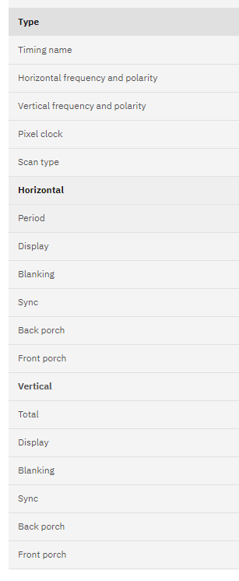
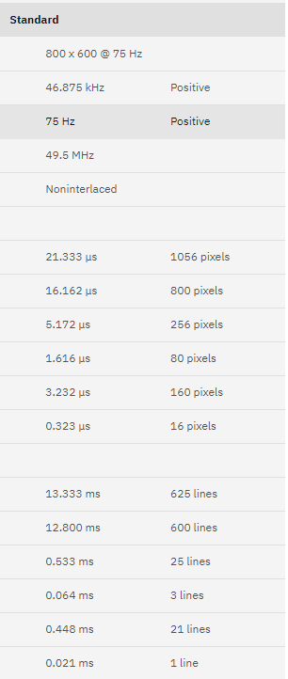
VGA
SYNCHRONIZATION GENERATOR
GENERATING VERTICAL AND HORIZONTAL SIGNALS TO USE THE VGA PORT ON NEXYS A7-100T
VGA timing standard for 800 x 600 resolution @ 75 Hz with a 50 MHz pixel clock.

Slide 7
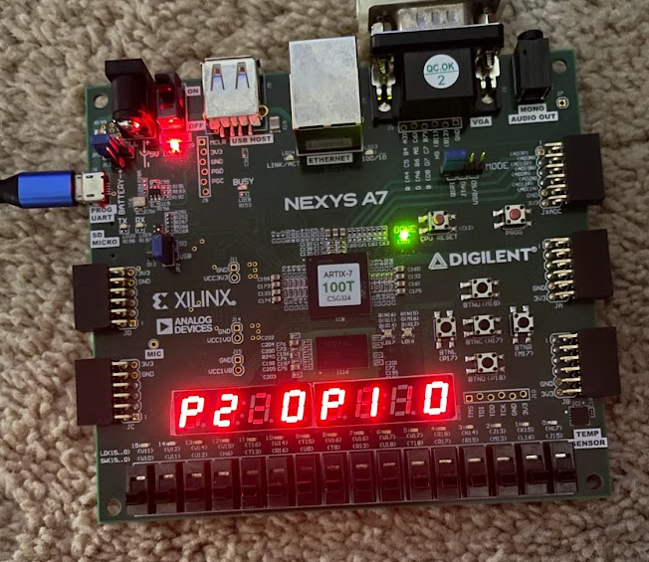
SEVEN SEGMENT
8 x 7-Segment Display
8 Anodes, 8 Cathodes, shared between digits.
Display multiplexing is used to display left player score and right player score with limited connections.
Switching between digits occurs so quickly, the human eye perceives image as static.

Slide 8
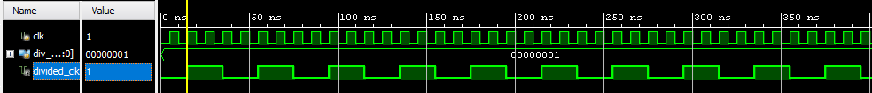
CLOCK DIVIDER
TWO INPUTS
CLK AND DIV_VALUE
ONE OUTPUT
DIV_CLOCK
USED IN VGA SYNCHRONIZATION GENERATOR TO GENERATE 50 MHz PIXEL CLOCK
FOR THE TARGET RESOLUTION 800x600 @75HZ
USED IN SEVEN SEGMENT DISPLAY TO GENERATE A 10 KHz CLOCK
ALLOWS US TO PROPERLY DISPLAY THE DIGITS USING MULTIPLEXER

Slide 9
PONG GRAPHICS
EIGHT INPUTS
Clk, left player input, right player input, pixel x, pixel y, random number, reset, and video on.
THREE OUTPUTS
RGB values, left player score, and right player score.
PROVIDES OUTPUTS FOR THE VGA MONITOR AND THE SEVEN-SEGMENT DISPLAY
TAKES CARE OF GAME LOGIC
Like when the ball hits paddle or a wall, the ball bounces back.
Sets ball and paddle position/speed at reset.
Moves ball and paddle and updates the on screen picture.

Slide 10
SWITCH DEBOUNCER
TO REMOVE THE UNEXPECTED BEHAVIOR
Mechanical switches
FOR USER INPUTS
LEFT AND RIGHT PLAYER UP AND DOWN SWITCH
RESET SWITCH
TAKES INPUTS AND CLEANS OUT THE INPUT
UNEXPECTED UP AND DOWN BOUNCES IN THE SWITCH SIGNAL
IMPLEMENTED A 5ms DELAY TO MAKE THE INPUT SWITCH STABLE

Slide 11
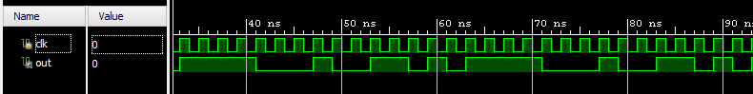
RANDOM NUMBER GENERATOR
We implemented a Linear FeedBack Shift Register to generate a Pseudo-Random sequence that outputs a 1-bit number. Our pseudo-random sequence has a period of 15 clock cycles before it overflows and repeats from the first value.

Slide 12
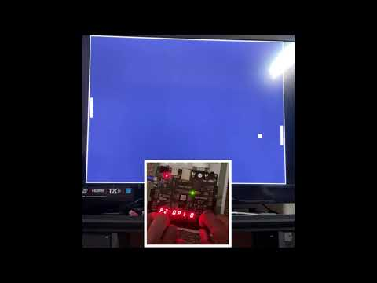
DEMO OF THE GAME

Slide 13
THE END

